Slide 1
Chapter 3: Main Memory

Slide 2
8.1.1 Basic Hardware
Main memory and the registers built into the processor itself are the only storage that the CPU can access directly. There are machine instructions that take memory addresses as arguments, but none that take disk addresses. Therefore, any instructions in execution, and any data being used by the instructions, must be in one of these direct-access storage devices. If the data are not in memory, they must be moved there before the CPU can operate on them.
Registers that are built into the CPU are generally accessible within one cycle of the CPU clock. The same cannot be said of main memory, which is accessed via a transaction on the memory bus. Completing a memory access may take many cycles of the CPU clock. In such cases, the processor normally needs to stall, since it does not have the data required to complete the instruction that it is executing.
The fast memory between the CPU and main memory is called as cache.
we must ensure correct operation to protect the operating system from access by user processes and, in addition, to protect user processes from one another. This protection must be provided by the hardware. It can be implemented in several ways. In this section, we outline one possible implementation.

Slide 3

We first need to make sure that each process has a separate memory space. To do this, we need the ability to determine the range of legal addresses that the process may access and to ensure that the process can access only these legal addresses. We can provide this protection by using two registers, usually a base and a limit, as illustrated in Figure 8.1.
The base register holds the smallest legal physical memory address and limit register the specifies the size of the range. For example, if the base register holds 300040 and the limit register is 120900, then the program can legally access all addresses from 300040 through 420939 (inclusive).
Figure 8.1 A base and a limit register define a logical address space.

Slide 4
Logical vs. Physical Address Space
The concept of a logical address space that is bound to a separate physical address space is central to proper memory management
  Logical address – generated by the CPU; also referred to as virtual address
  Physical address – address seen by the memory unit
Logical and physical addresses are the same in compile-time and load-time address-binding schemes; logical (virtual) and physical addresses differ in execution-time address-binding scheme
Logical address space is the set of all logical addresses generated by a program
Physical address space is the set of all physical addresses generated by a program

Slide 5

Dynamic relocation using a relocation register
Relocation registers used to protect user processes from each other, and from changing operating-system code and data
  Base register contains value of smallest physical address
  Limit register contains range of logical addresses – each logical address must be less than the limit register
  MMU maps logical address dynamically

Slide 6
Swapping
A process can be swapped temporarily out of memory to a backing store, and then brought back into memory for continued execution
  Total physical memory space of processes can exceed physical memory
Backing store – fast disk large enough to accommodate copies of all memory images for all users; must provide direct access to these memory images
Roll out, roll in – swapping variant used for priority-based scheduling algorithms; lower-priority process is swapped out so higher-priority process can be loaded and executed
Major part of swap time is transfer time; total transfer time is directly proportional to the amount of memory swapped
System maintains a ready queue of ready-to-run processes which have memory images on disk

Slide 7

Schematic View of Swapping

Slide 8
Context Switch Time including Swapping
If next processes to be put on CPU is not in memory, need to swap out a process and swap in target process
Context switch time can then be very high
User process=10MB in size and backing store has transfer rate of 40MB per sec. the actual transfer of this process to or from main memory takes:10000kb/40000kb per sec=1/4sec=250msec.
  Assuming average latency of 8msec
  Hence the swap time is 258 msec
  And total swap time is 258+258=516msec

Slide 9
Contiguous Allocation
Main memory must support both OS and user processes
Limited resource, must allocate efficiently
Contiguous allocation is one early method
Main memory usually divided into two partitions:
  Resident operating system, usually held in low memory with interrupt vector
  User processes then held in high memory
  Each process contained in single contiguous section of memory

Slide 10
Contiguous Allocation (Cont.)
Relocation registers used to protect user processes from each other, and from changing operating-system code and data
  Base register contains value of smallest physical address
  Limit register contains range of logical addresses – each logical address must be less than the limit register
  MMU maps logical address dynamically

Slide 11

Hardware Support for Relocation and Limit Registers

Slide 12

Multiple-partition allocation
Multiple-partition allocation: divide memory into several fixed sized partitions.each partition may contain exactly 1 process.
  Degree of multiprogramming limited by number of partitions
  Variable-partition sizes for efficiency (sized to a given process’ needs)
  Hole – block of available memory; holes of various size are scattered throughout memory
  When a process arrives, it is allocated memory from a hole large enough to accommodate it
  Process exiting frees its partition, adjacent free partitions combined
  Operating system maintains information about:
  a) allocated partitions b) free partitions (hole)

Slide 13
Dynamic Storage-Allocation Problem
How to satisfy a request of size n from a list of free holes?
First-fit: Allocate the first hole that is big enough. Searching can start either at the beginning of the set of holes or at the location where the previous first-fit search ended. We can stop searching as soon as we find a free hole that is large enough.
Best-fit :Allocate the smallest hole that is big enough. We must search the entire list, unless the list is ordered by size. This strategy produces the smallest leftover hole.
Worst-fit: Allocate the largest hole. Again, we must search the entire list, unless it is sorted by size. This strategy produces the largest leftover hole, which may be more useful than the smaller leftover hole from a best-fit approach.
First-fit and best-fit better than worst-fit in terms of speed and storage utilization

Slide 14
Segmentation
Memory-management scheme that supports user view of memory
A program is a collection of segments
  A segment is a logical unit such as:
main program
procedure
function
method
object
local variables, global variables
common block
stack
symbol table
arrays

Slide 15

User’s View of a Program

Slide 16
Logical View of Segmentation
1
1
4
2
3
4
2
3
user space
physical memory space

Slide 17
Segmentation Architecture
Logical address consists of a two tuple:
<segment-number, offset>,
Segment table – maps two-dimensional physical addresses; each table entry has:
  base – contains the starting physical address where the segments reside in memory
  limit – specifies the length of the segment
Segment-table base register (STBR) points to the segment table’s location in memory
Segment-table length register (STLR) indicates number of segments used by a program;
segment number s is legal if s < STLR

Slide 18
Segmentation Architecture (Cont.)
Protection
  With each entry in segment table associate:
    validation bit = 0 ⇒ illegal segment
    read/write/execute privileges
Protection bits associated with segments; code sharing occurs at segment level
Since segments vary in length, memory allocation is a dynamic storage-allocation problem
A segmentation example is shown in the following diagram

Slide 19

Segmentation Hardware

Slide 20
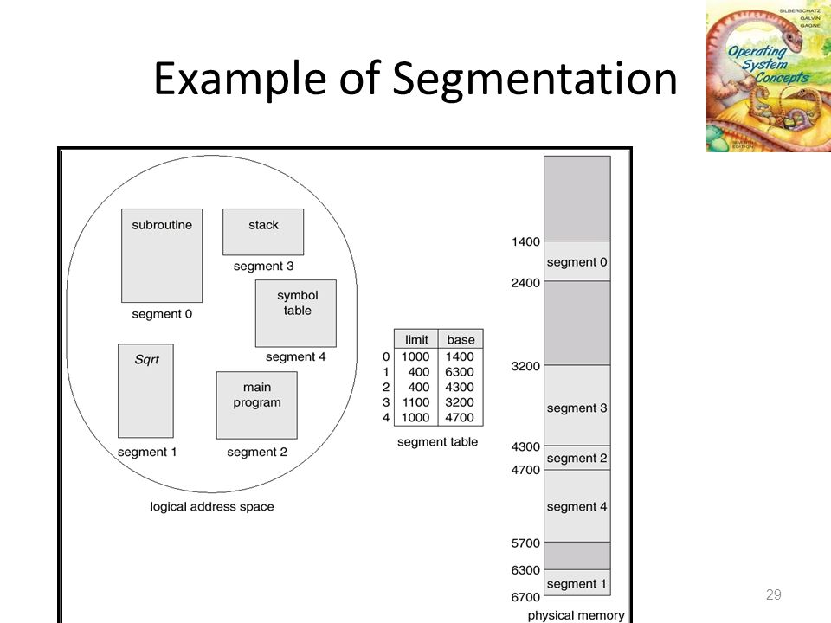

Slide 21
Paging
Physical address space of a process can be noncontiguous; process is allocated physical memory whenever the latter is available
  Avoids external fragmentation
  Avoids problem of varying sized memory chunks
Divide physical memory into fixed-sized blocks called frames
  Size is power of 2, between 512 bytes and 16 Mbytes
Divide logical memory into blocks of same size called pages
Keep track of all free frames
To run a program of size N pages, need to find N free frames and load program
Set up a page table to translate logical to physical addresses
Backing store likewise split into pages
Still have Internal fragmentation

Slide 22

Address Translation Scheme
Address generated by CPU is divided into:
  Page number (p) – used as an index into a page table which contains base address of each page in physical memory
  Page offset (d) – combined with base address to define the physical memory address that is sent to the memory unit
  For given logical address space 2^{m} and page size 2^{n}

Slide 23

Paging Hardware

Slide 24

Paging Model of Logical and Physical Memory

Slide 25

Paging Example
n=2 and m=4 32-byte memory and 4-byte pages

Slide 26

Free Frames
Before allocation
After allocation

Slide 27
Implementation of Page Table
Page table is kept in main memory
Page-table base register (PTBR) points to the page table
Page-table length register (PTLR) indicates size of the page table
In this scheme every data/instruction access requires two memory accesses
  One for the page table and one for the data / instruction
The two memory access problem can be solved by the use of a special fast-lookup hardware cache called associative memory or translation look-aside buffers (TLBs)

Slide 28
Implementation of Page Table (Cont.)
Some TLBs store address-space identifiers (ASIDs) in each TLB entry – uniquely identifies each process to provide address-space protection for that process
  Otherwise need to flush at every context switch
TLBs typically small (64 to 1,024 entries)
On a TLB miss, value is loaded into the TLB for faster access next time
  Replacement policies must be considered
  Some entries can be wired down for permanent fast access

Slide 29

Paging Hardware With TLB

Slide 30
EFFECTIVE ACCESS TIME
Effective access time=hit(TLB+MM)+miss(TLB+Pagetable+MM)
An 80-percent hit ratio, for example, means that we find the desired page number in the TLB 80 percent of the time. If it takes 20 nanoseconds to search the TLB and 100 nanoseconds to access memory, then a mapped-memory access takes 120 nanoseconds when the page number is in the TLB. If we fail to find the page number in the TLB (20 nanoseconds), then we must first access memory for the page table and frame number (100 nanoseconds) and then access the desired byte in memory (100 nanoseconds), for a total of 220 nanoseconds.
To find the effective memory access time we weight the case by its probability:
effective access time = 0.80 x 120 + 0.20 x 220= 140 nanoseconds.
In this example, we suffer a 40-percent slowdown in memory-access time.
For a 98-percent hit ratio, we have
effective access time = 0.98 x 120 + 0.02 x 220= 122 nanoseconds.
This increased hit rate produces only a 22 percent slowdown in access time.

Slide 31
Memory Protection
Memory protection implemented by associating protection bit with each frame to indicate if read-only or read-write access is allowed
  Can also add more bits to indicate page execute-only, and so on
Valid-invalid bit attached to each entry in the page table:
  “valid” indicates that the associated page is in the process’ logical address space, and is thus a legal page
  “invalid” indicates that the page is not in the process’ logical address space
  Or use page-table length register (PTLR)
Any violations result in a trap to the kernel

Slide 32

Valid (v) or Invalid (i) Bit In A Page Table

Slide 33
Shared Pages
Shared code
  One copy of read-only (reentrant) code shared among processes (i.e., text editors, compilers, window systems)
  Similar to multiple threads sharing the same process space
  Also useful for interprocess communication if sharing of read-write pages is allowed
Private code and data
  Each process keeps a separate copy of the code and data
  The pages for the private code and data can appear anywhere in the logical address space

Slide 34

Shared Pages Example

